Slide 1
Introduction to Philosophy
Session 3
Doing Philosophy: Arguments
ar·gu·ment
noun
1.
an exchange of diverging or opposite views, typically a heated or angry one.
"I've had an argument with my father"
2.
a reason or set of reasons given with the aim of persuading others that an action or idea is right or wrong.
"there is a strong argument for submitting a formal appeal"

Slide 2
Introduction to Philosophy
Session 3
Doing Philosophy: Arguments
https://www.youtube.com/watch?v=Cum3k-Wglfw&list=PLtKNX4SfKpzX_bhh4LOEWEGy3pkLmFDmk&index=1

Slide 3
Introduction to Philosophy
Session 3
Doing Philosophy: Arguments
VALID ARGUMENT
If premises are true, conclusion is true

Slide 4
Introduction to Philosophy
Session 3
Doing Philosophy: Arguments
Premise 1: You are either hungry or tired
Premise 2: You are not hungry
Conclusion: You are tired
VALID

Slide 5
Introduction to Philosophy
Session 3
Doing Philosophy: Arguments
Premise 1: All men are mortal
Premise 2: Socrates is a man
Conclusion: Socrates is mortal
VALID

Slide 6
Introduction to Philosophy
Session 3
Doing Philosophy: Arguments
Premise 1: All students are smart
Premise 2: Jennifer is a student
Conclusion: Jennifer is smart
VALID

Slide 7
Introduction to Philosophy
Session 3
Doing Philosophy: Arguments
Premise 1: Some students are smart
Premise 2: Jennifer is a student
Conclusion: Jennifer is smart
INVALID

Slide 8
Introduction to Philosophy
Session 3
Doing Philosophy: Arguments
Premise 1: Jennifer is a student
Premise 2: Jennifer is smart
Conclusion: All students are smart
INVALID

Slide 9
Introduction to Philosophy
Session 3
Doing Philosophy: Arguments
Premise 1: Peter is made of oatmeal
Premise 2: Oatmeal is an animal
Premise 3: All animals are yellow
Premise 4: Yellow is the same as green
Conclusion: Peter is green
VALID

Slide 10
Introduction to Philosophy
Session 3
Doing Philosophy: Arguments
Premise 1: A is made of B
Premise 2: B is C
Premise 3: All C is f
Premise 4: f is the same as g
Conclusion: A is g
VALID

Slide 11
Introduction to Philosophy
Session 3
Doing Philosophy: Arguments
Premise 1: 7 is more than 2
Premise 2: McDonalds sells burgers
Conclusion: Brooklyn is part of New York City
INVALID

Slide 12
Introduction to Philosophy
Session 3
Doing Philosophy: Arguments
Premise 1: A is more than B
Premise 2: C sells D
Conclusion: E is part of F
INVALID

Slide 13
Introduction to Philosophy
Session 3
Doing Philosophy: Arguments
SOUND ARGUMENT
A valid argument with true premises

Slide 14
Introduction to Philosophy
Session 3
Doing Philosophy: Arguments
NOT SOUND
Premise 1: You are either hungry or tired
Premise 2: You are not hungry
Conclusion: You are tired

Slide 15
Introduction to Philosophy
Session 3
Doing Philosophy: Arguments
Premise 1: All men are mortal
Premise 2: Socrates is a man
Conclusion: Socrates is mortal
SOUND

Slide 16
Introduction to Philosophy
Session 3
Doing Philosophy: Arguments
Premise 1: All students are smart
Premise 2: Jennifer is a student
Conclusion: Jennifer is smart
NOT SOUND

Slide 17
Introduction to Philosophy
Session 3
Doing Philosophy: Arguments
Premise 1: Some students are smart
Premise 2: Jennifer is a student
Conclusion: Jennifer is smart
NOT SOUND

Slide 18
Introduction to Philosophy
Session 3
Doing Philosophy: Arguments
Premise 1: Jennifer is a student
Premise 2: Jennifer is smart
Conclusion: All students are smart
NOT SOUND

Slide 19
Introduction to Philosophy
Session 3
Doing Philosophy: Arguments
Premise 1: Peter is made of oatmeal
Premise 2: Oatmeal is an animal
Premise 3: All animals are yellow
Premise 4: Yellow is the same as green
Conclusion: Peter is green
NOT SOUND

Slide 20
Introduction to Philosophy
Session 3
Doing Philosophy: Arguments
Premise 1: A is made of B
Premise 2: B is C
Premise 3: All C is f
Premise 4: f is the same as g
Conclusion: A is g
?

Slide 21
Introduction to Philosophy
Session 3
Doing Philosophy: Arguments
Premise 1: 7 is more than 2
Premise 2: McDonalds sells burgers
Conclusion: Brooklyn is part of New York City
NOT SOUND

Slide 22
Introduction to Philosophy
Session 3
Doing Philosophy: Arguments
Premise 1: A is more than B
Premise 2: C sells D
Conclusion: E is part of F
NOT SOUND

Slide 23
Introduction to Philosophy
Session 3
Doing Philosophy: Arguments

Slide 24
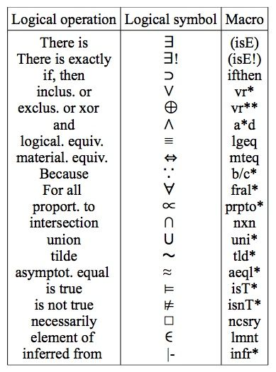
Introduction to Philosophy
Session 3
Doing Philosophy: Arguments

Slide 25
Introduction to Philosophy
Session 3
Doing Philosophy: Arguments
NECESSARY CONDITION
Q is true only if P is true
SUFFICIENT CONDITION
If R is true, then S is true

Slide 26
Introduction to Philosophy
Session 3
Doing Philosophy: Arguments
https://www.youtube.com/watch?v=9uOF3AZI_Gc&list=PLtKNX4SfKpzX_bhh4LOEWEGy3pkLmFDmk&index=8

